Slide 1
Drivers for a PRAGMA Biodiversity Science Expedition
Reed Beaman
Florida Museum of Natural History
University of Florida

Slide 2
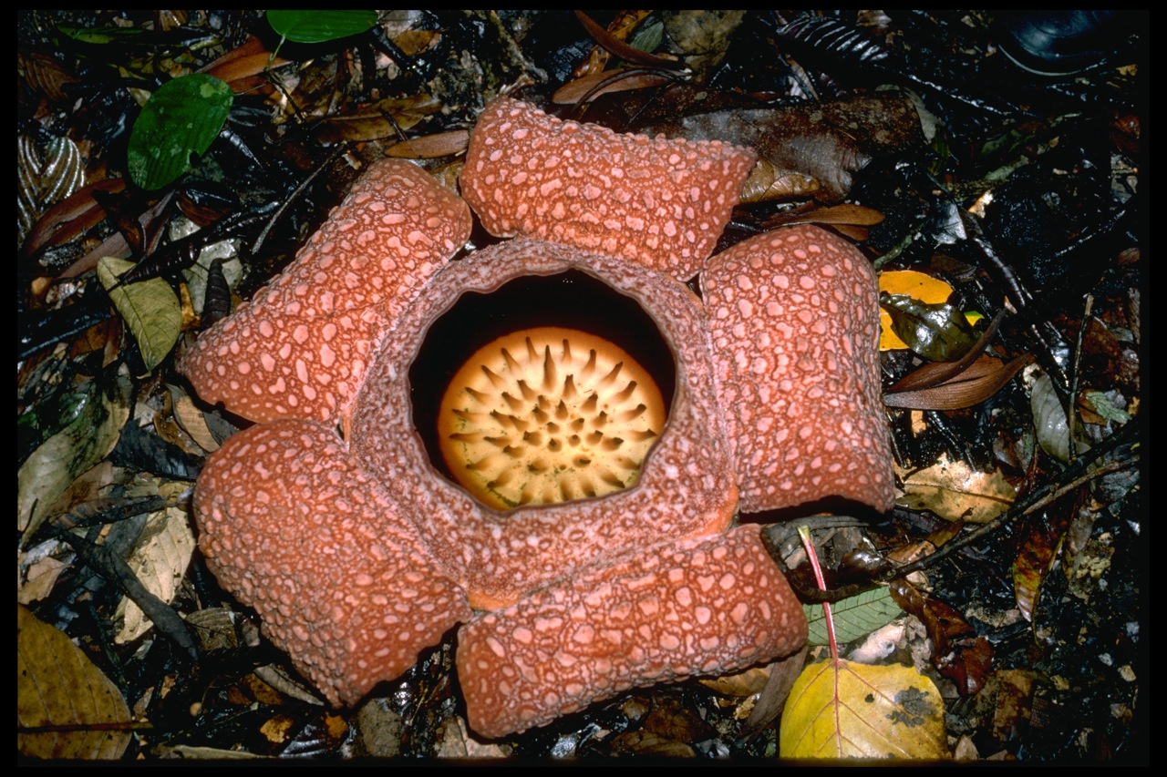
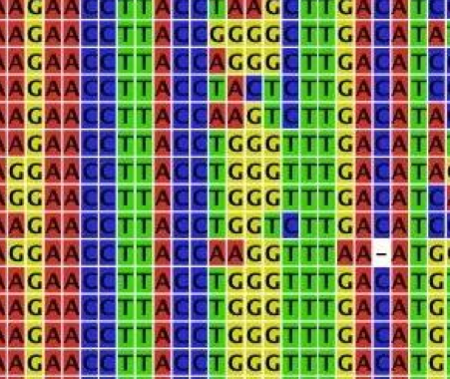
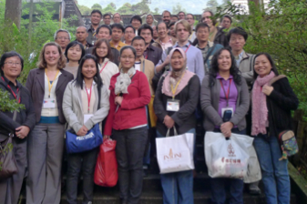
Expedition Planning
Priorities based on questions and challenges in
Biodiversity Science
Information and Cyber- infrastructure
Education, Training,
Outreach
Notes:
Where are we going, how are we going to get there, what happens once we get there

Slide 3
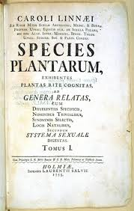
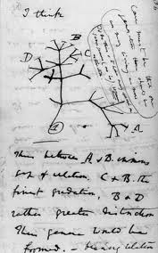
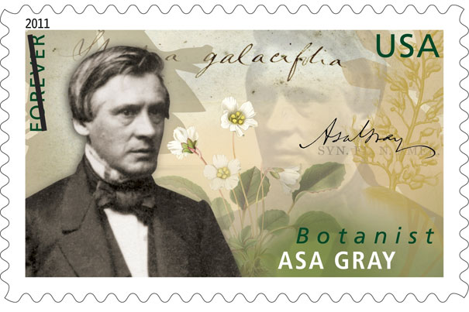
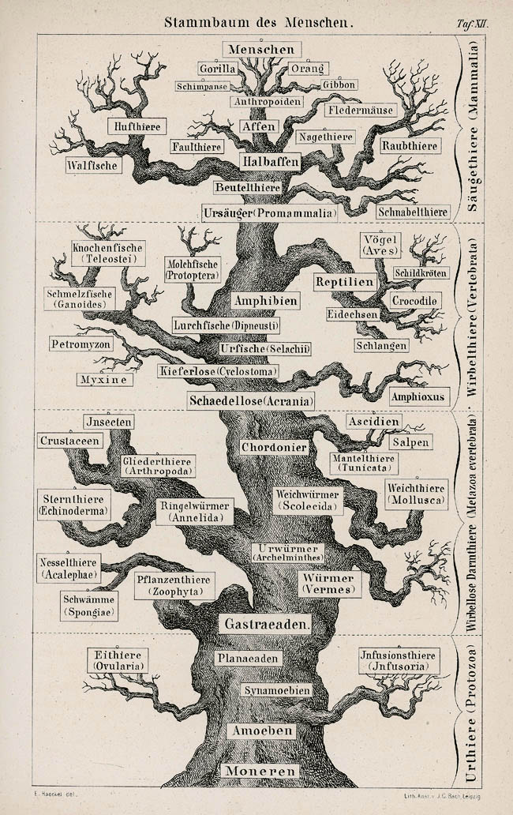
Biological Diversity
Biodiversity: the variety of all forms of life, from genes to species, through to the broad scale of ecosystems.
Notes:
Lessons learned as a NSF PD.
I come to you out of the biodiversity, biological systematics, scientific collections community
Community is broader/bigger than I imagined

Slide 4
Biodiversity Science
Grand Challenge (one of five) at the intersection of Physical and Life Sciences (US NRC Report)
Understanding biological complexity and interaction is fundamental.
Biotic <-> abiotic
Downstream: Leading environmental and social issue as the human population grows, landscapes are modified, and our regional and global climate changes.

Slide 5
Why Southeast Asia?
Globally significant areas of high biodiversity
Unique opportunities to understand biological processes and factors
spectacular richness of form and function, genetic and phylogenetic diversity.
Multitude of islands in the Malay Archipelago, and the isolation effects.
high human and economic growth increase urgency

Slide 6
SEAIP Biodiversity Examples
DNA fingerprinting of timber products
natural products chemistry
Linked data efforts
Geospatial integration
species distribution and habitat modeling in general, and in particular in ultramafic (serpentine) regions.

Slide 7
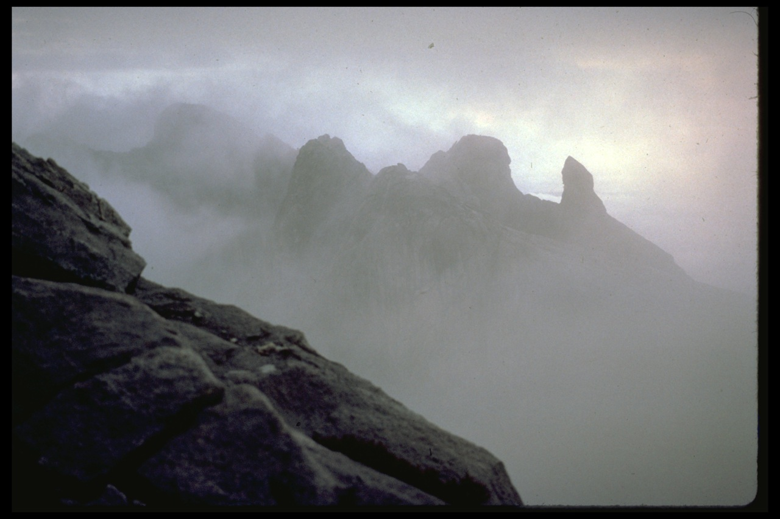
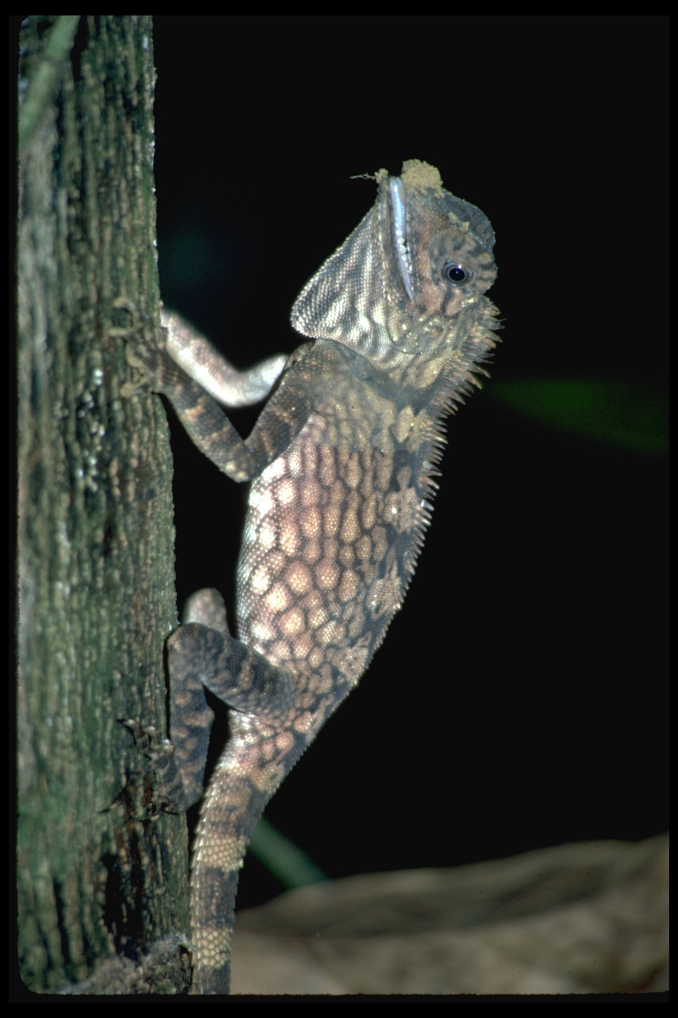
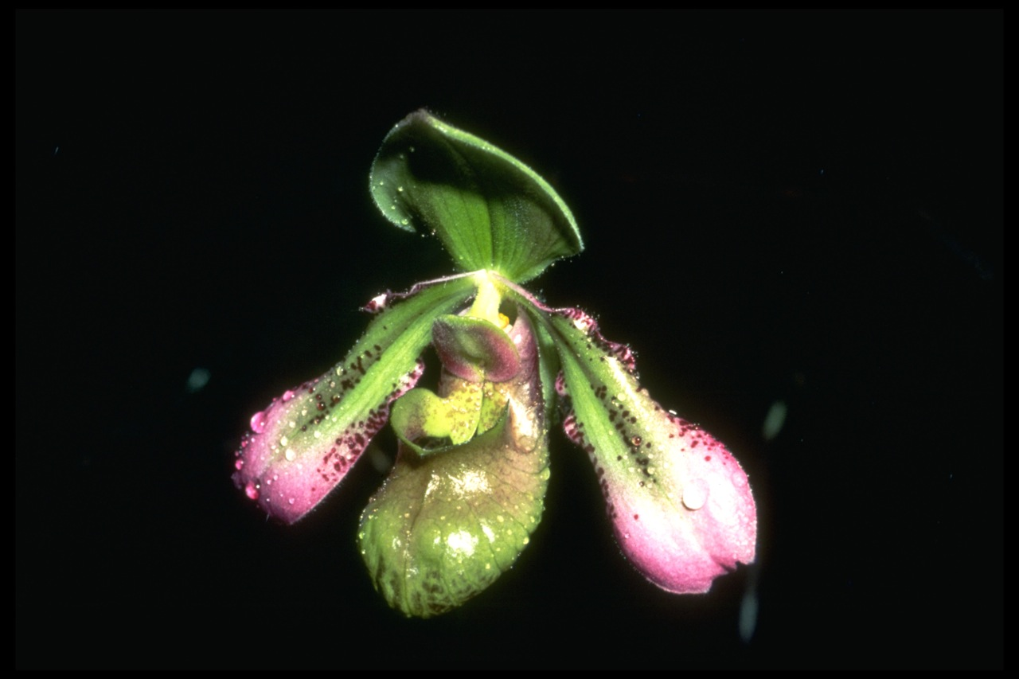
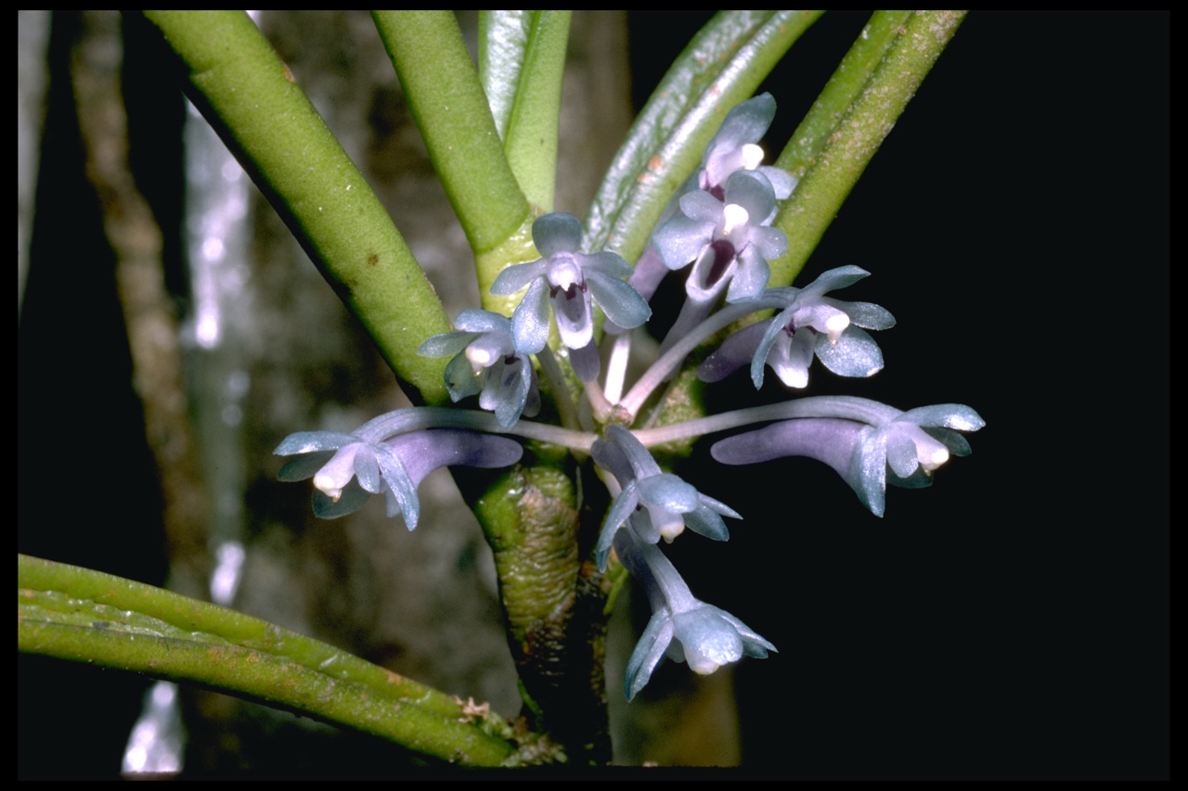
Northern Borneo is a global biodiversity hotspot.

Slide 8
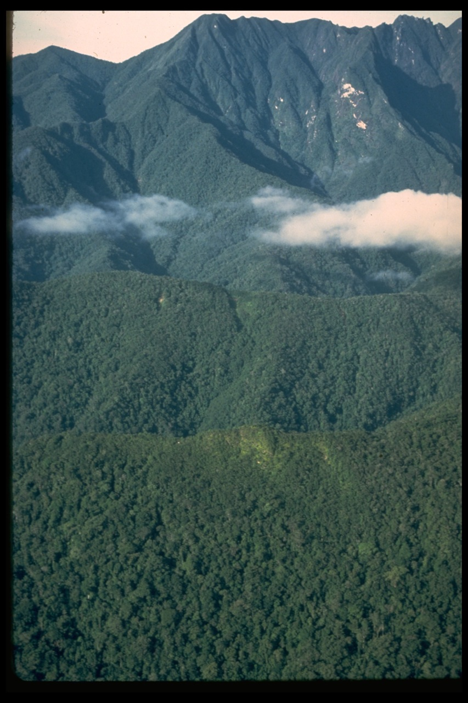
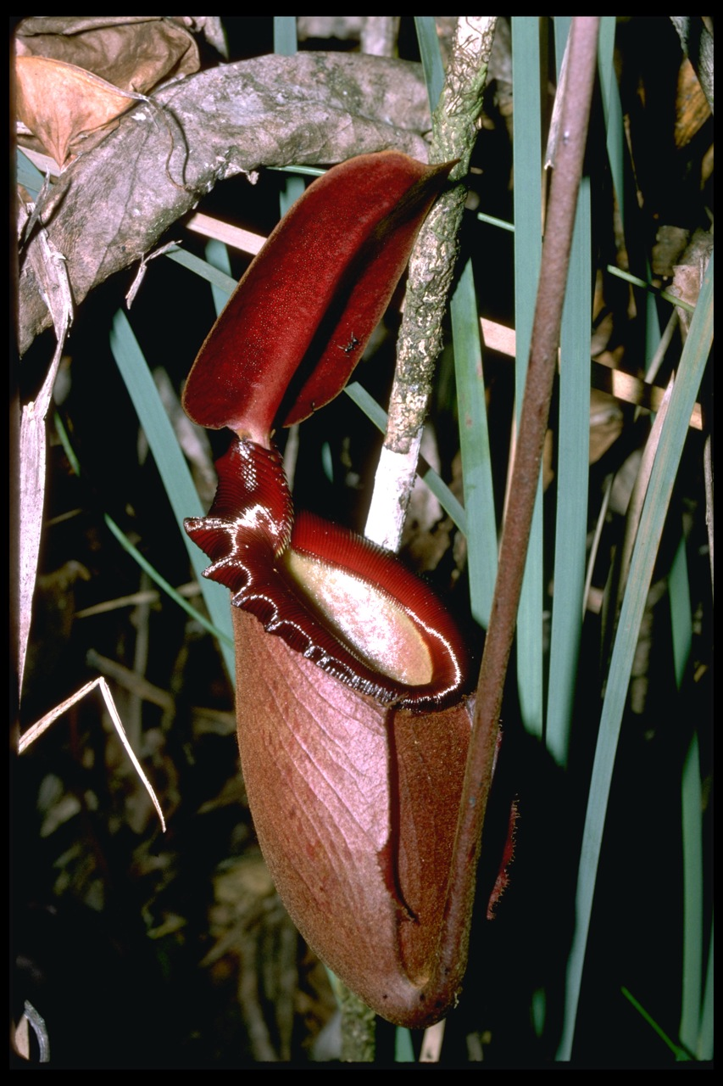
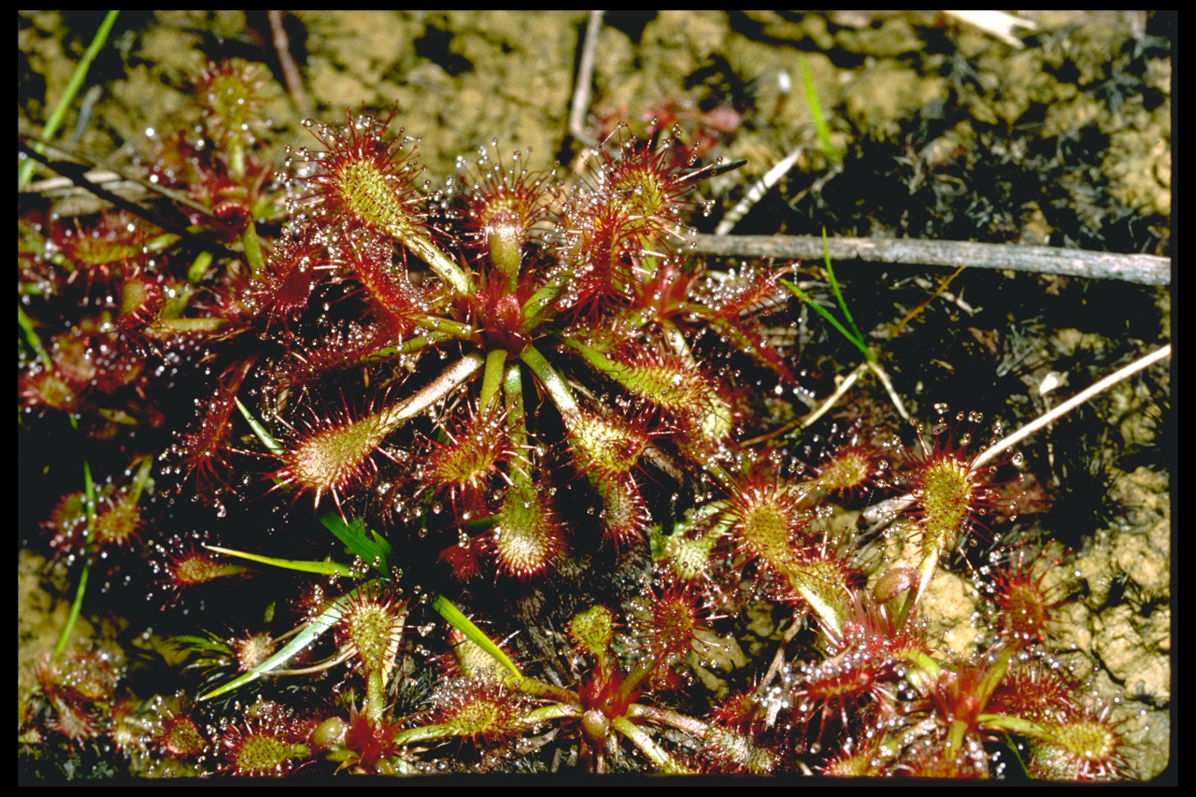
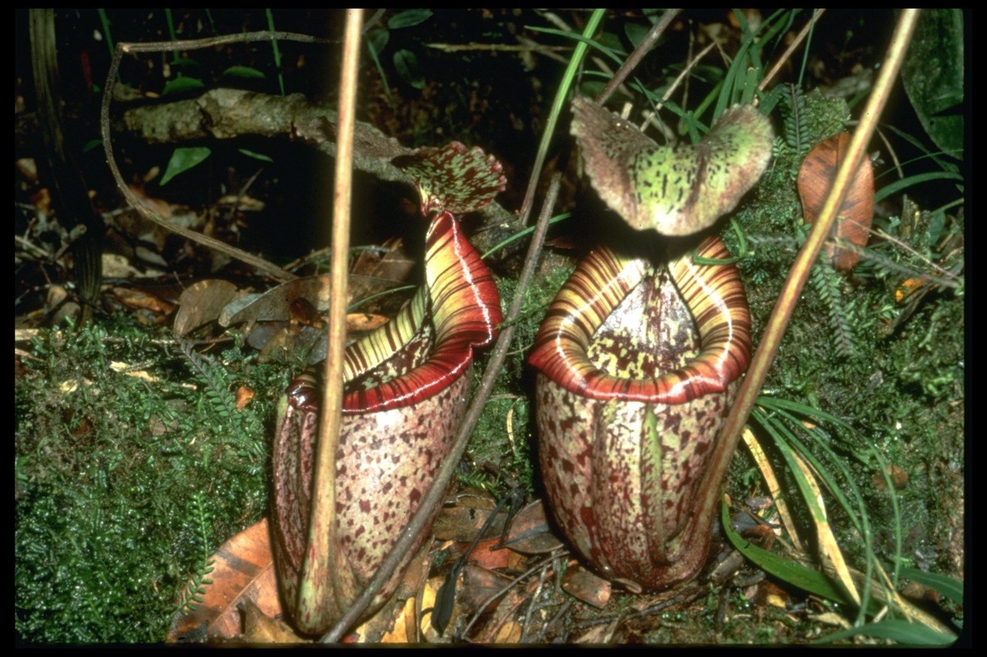
Model systems: Ultramafic Ecosystems
high degree of endemism (edaphic islands)
distinctive phenotypic features and ecology
Adaptations: carnivory in plants, hyperacumulation of metals.
Community composition, structure and function

Slide 9
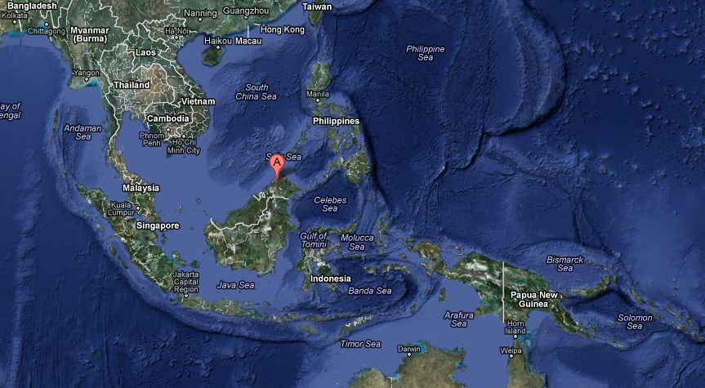
Supermodel system: Diverse, well-known ultramafic ecosystems on Mount Kinabalu in Sabah, Malaysia

Slide 10
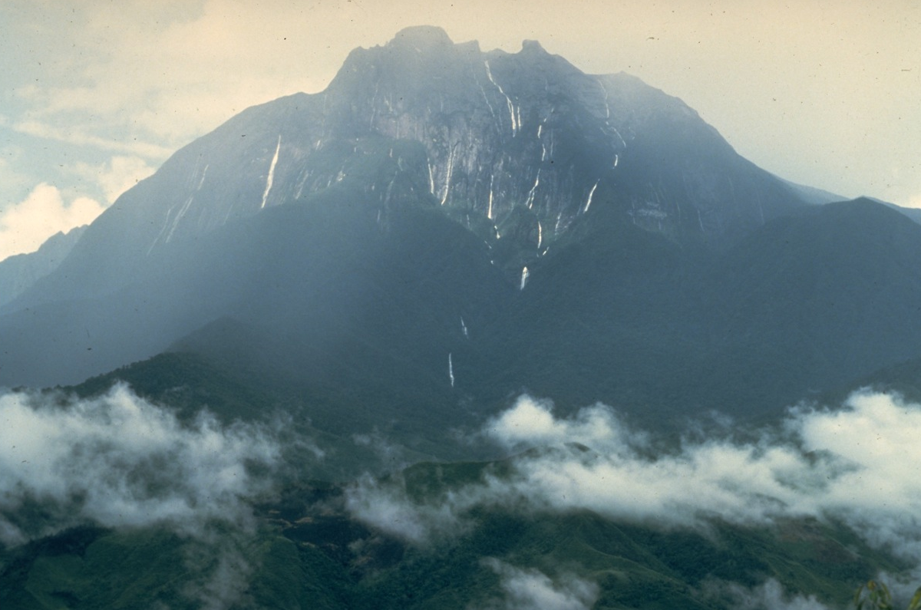
Highest mountain (4,095 m) between the Himalayas and New Guinea.

Slide 11
Infrastructure: Data
Essential for integrating genetics, systematics, phylogenetics, genomics, ecology, physiology
Transforming data into knowledge networks
Linked data, metadata, provenance
Ontologies, semantic web
Biotic and abiotic data integration
Organism occurrence, remote sensing, climate

Slide 12
Cyberinfrastructure challenges
Innovative and sustainable software and data repositories
Documenting organisms in nature systems -> digitized, accessible scientific collections and digitization (Fortes, Belbin)
Integrating analytical tools (Laffan, Stewart)
Computation
Hyperspectral image analysis over time
Genetics, phylogenetics, phylogeograpy
Networking
Sensor networks (climate)
Collaboration platforms (last mile problems)

Slide 13
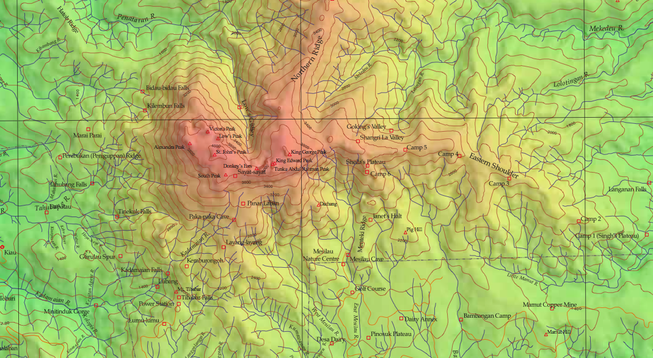
Data resources: starting small
Kinabalu flora database – ca. 70,000 specimen occurrence records,
5000 species of vascular plants occur in an area of 1,200 sq. km.
Geospatial data
Georeferenced occurrences
Remote sensing
DEMs

Slide 14
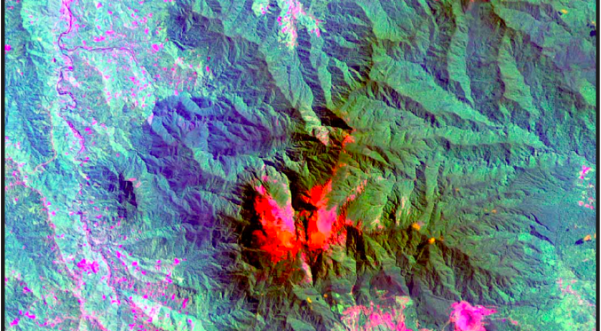
Remote recognition

Slide 15
A large scale question
Amborella, the species at the base of the flowering plant tree of life, occurs on ultramafics in New Caledonia.
Were the earliest evolutionary radiations of the flowering plants on ultramafics?
Hypothesis: In a large scale phylogeographic analysis of flowering plans in SEA, we would expect to find basal taxa in multiple clades of the deep tree to be on ultramafics.

Slide 16
Infrastructure: Conceptual planning – a task for afternoon session?
stakeholders, collaboration, and communities of practice
computation, including hardware, software, and data architectures and lifecycles
identification of dependencies for data, tools, and other technologies,
development, testing and deployment
user experience and interfaces,
management, organizational structure, and sustainability
risk assessment.

Slide 17
Thanks!
To PRAGMA 22 organizers and hosts
David Abramson
Peter Arzberger
Jin Chao
Monash University
Participants

